Slide 1
Zomato’s Aggregate Rating Breakdown
Ben Fujii, Nick Webster, Keivan Golchini, Jason Cabardo, Raina Rode
Notes:
Ben/Raina

Slide 2
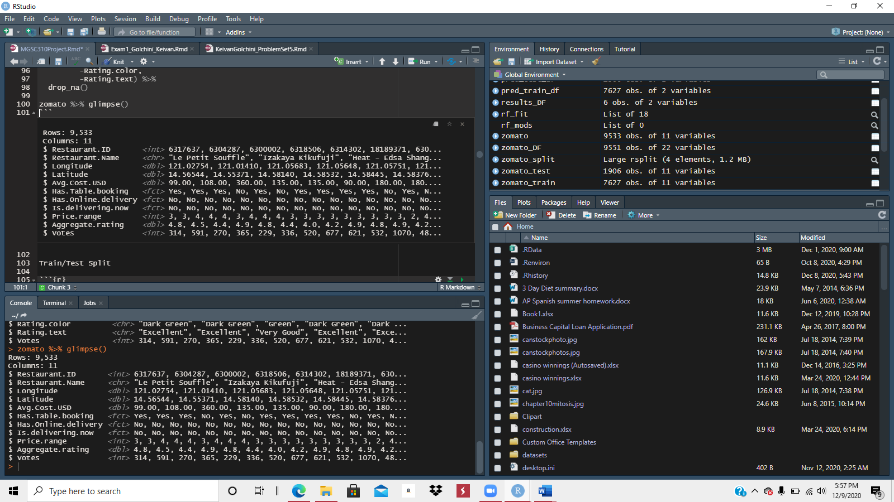
OUR DATA
GOAL
11 variables
Zomato Restaurants Data via Kaggle
Provides information, menus and user-reviews of restaurants
Food delivery options from partner restaurants
Find aggregate rating of restaurants
What variables attribute to a highly rated restaurant
Can we find an accurate prediction?
Notes:
Ben/Raina

Slide 3
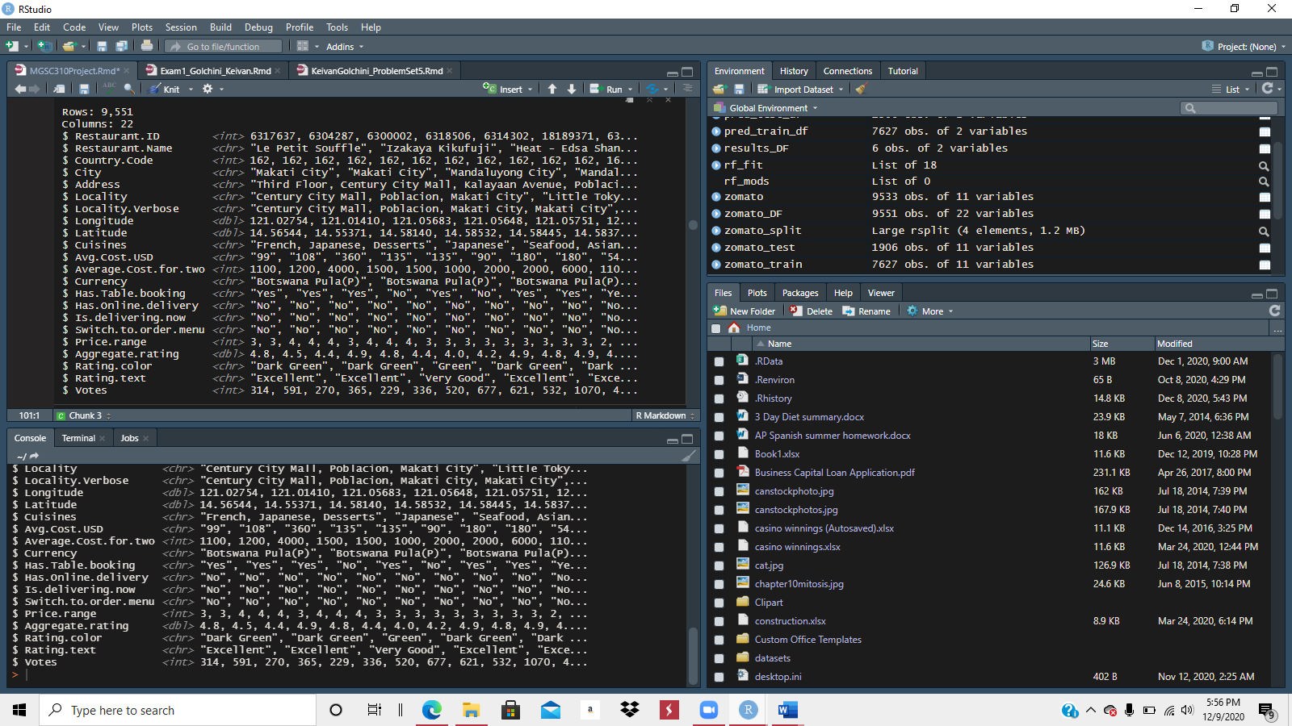
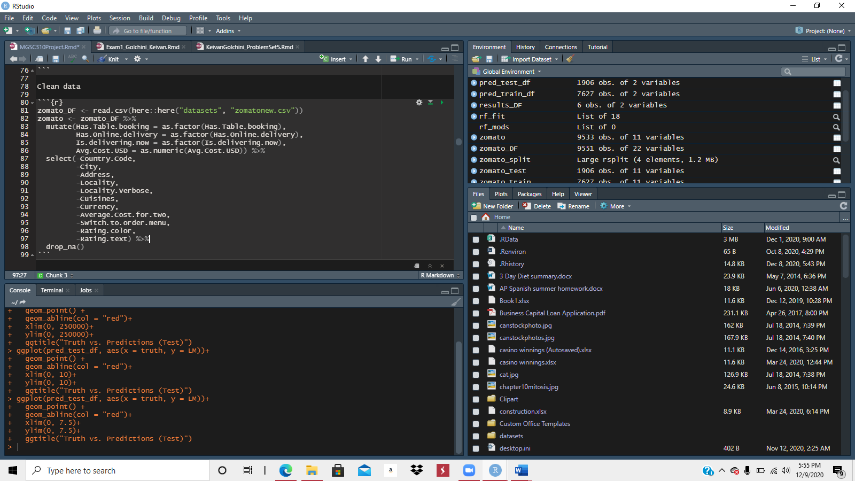
HOW WE CLEANED
Change variables to factors and numerics
Remove variables
Remove N/A values
Notes:
Ben/Raina

Slide 4
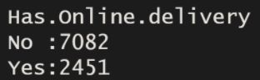
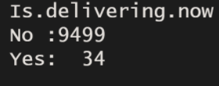
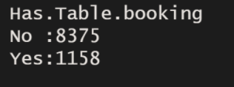
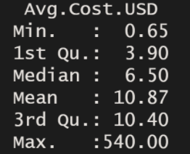
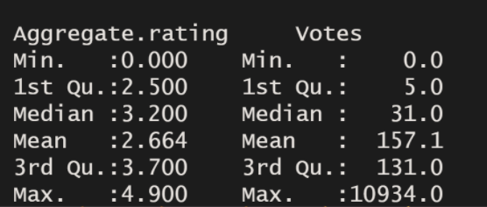
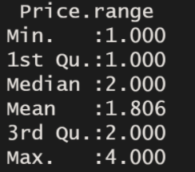
Exploratory Analysis
Notes:
Jason

Slide 5
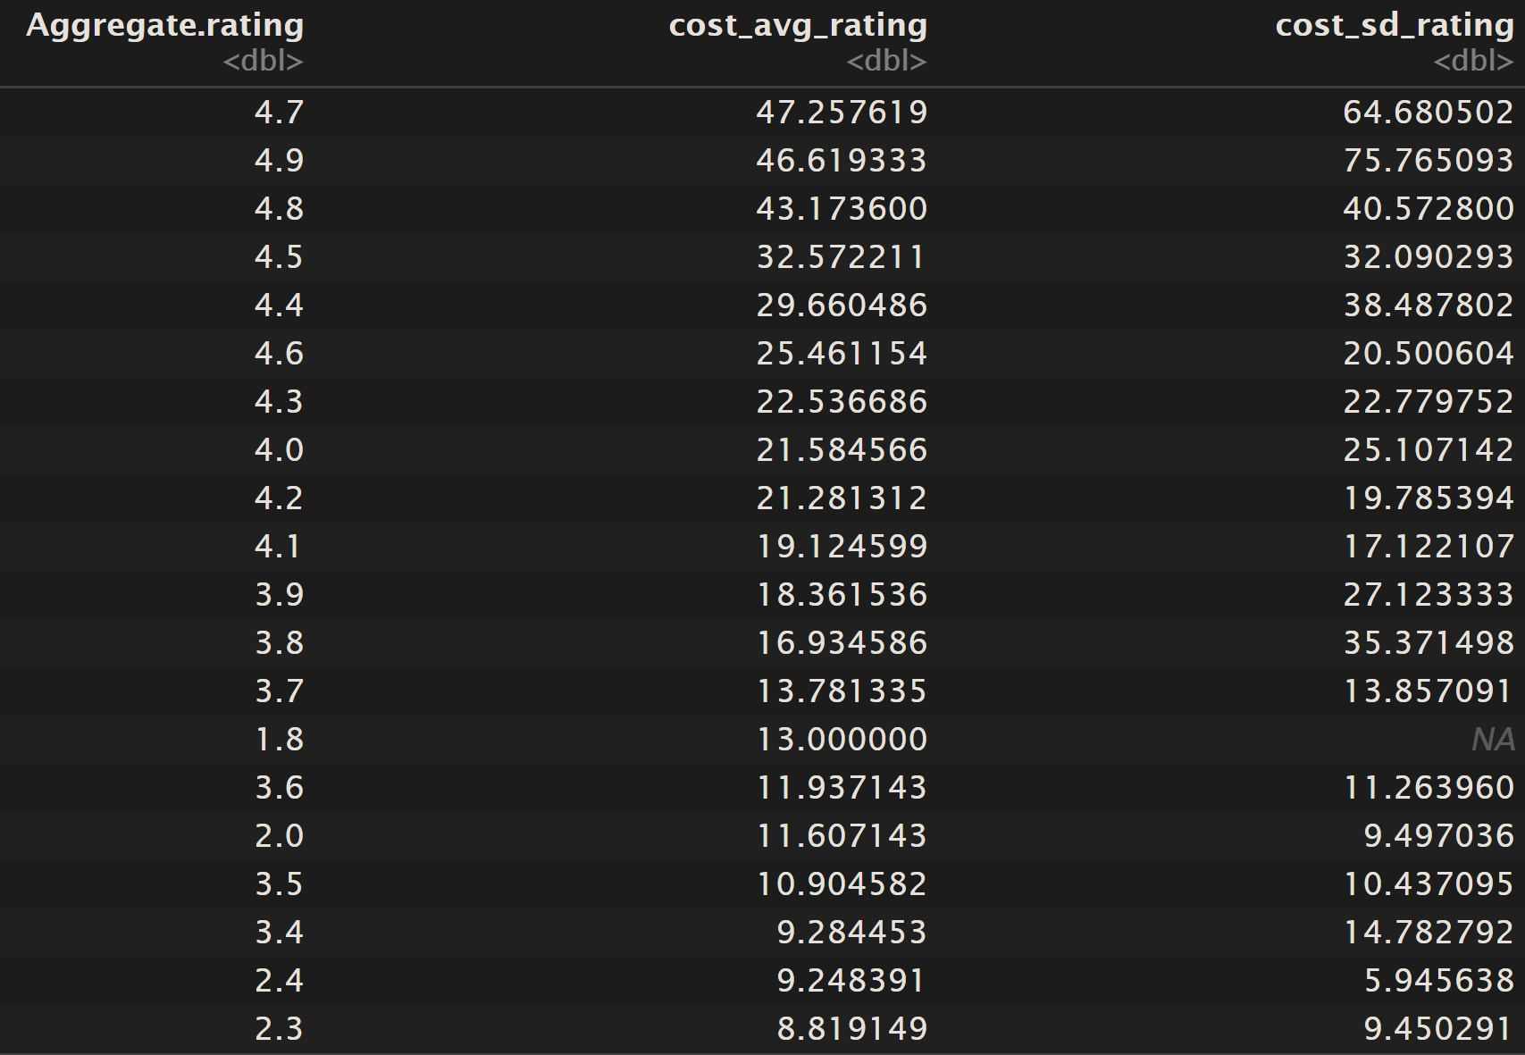
FURTHER EXPLORATORY ANALYSIS
Notes:
Jason

Slide 6
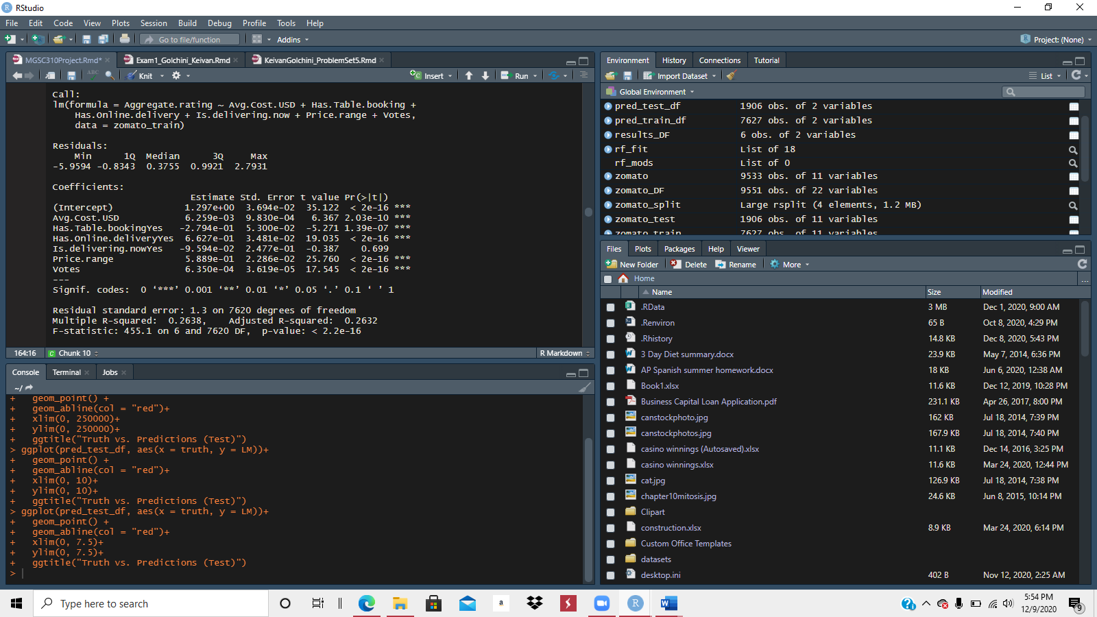
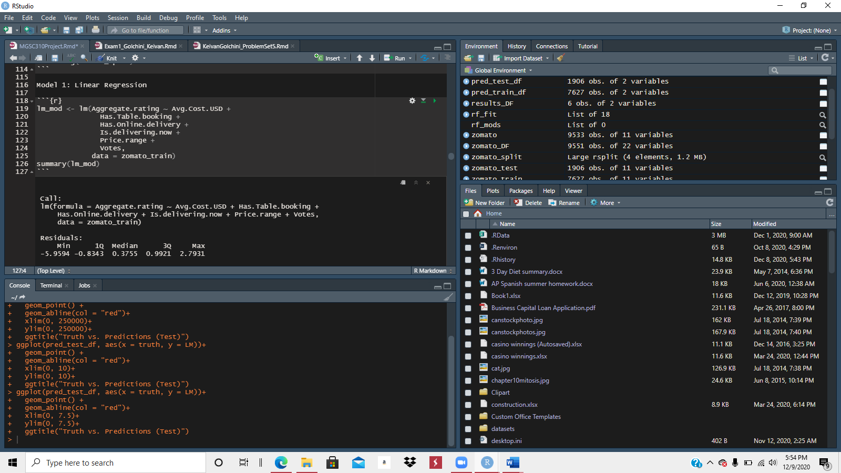
LINEAR REGRESSION
Notes:
Keivan

Slide 7
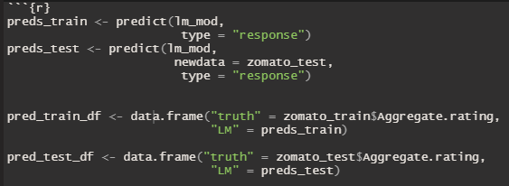
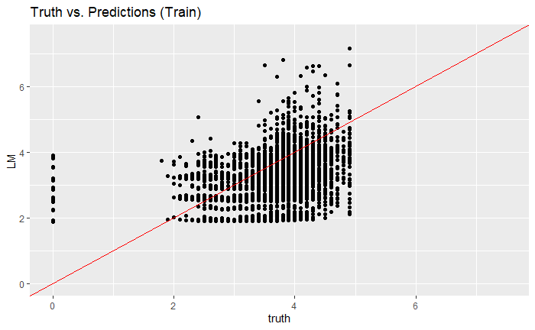
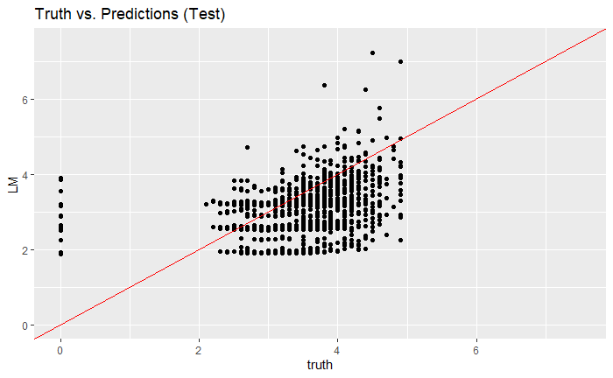
LINEAR REGRESSION PREDICTIONS
Notes:
Keivan

Slide 8
LINEAR REGRESSION METRICS
Train
Test
R2 | 0.264
RMSE | 1.300
R2 | 0.290
RMSE | 1.286
Notes:
Keivan

Slide 9
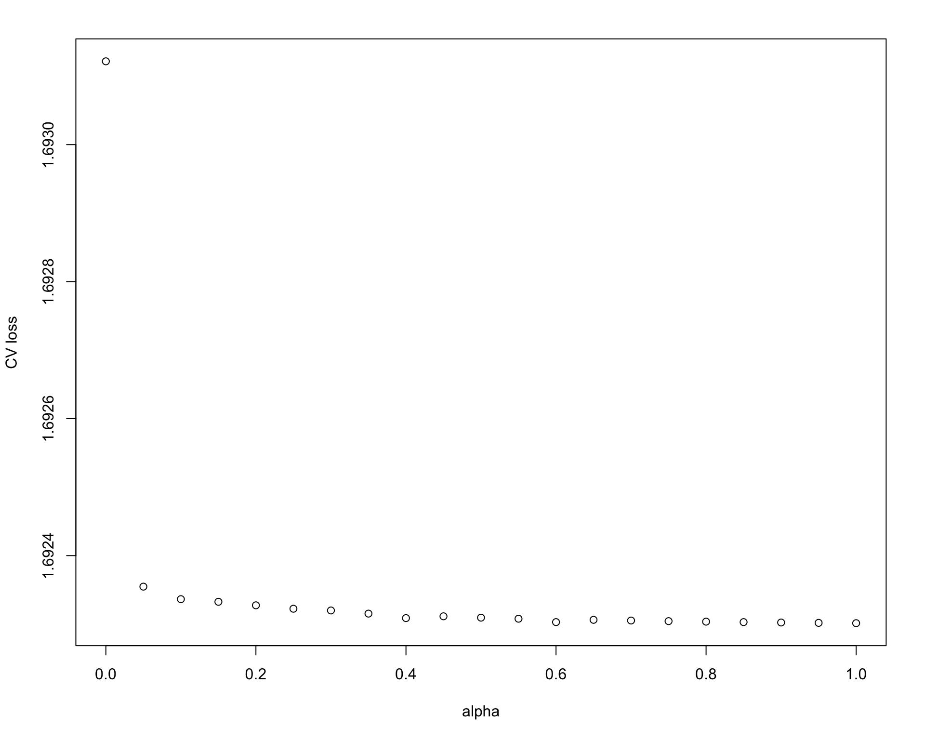
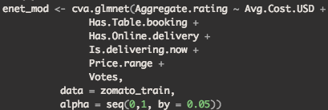
ELASTIC NET REGRESSION
MIN LOSS PLOT
Optimal Alpha | 0.95
Notes:
Ben/Raina

Slide 10
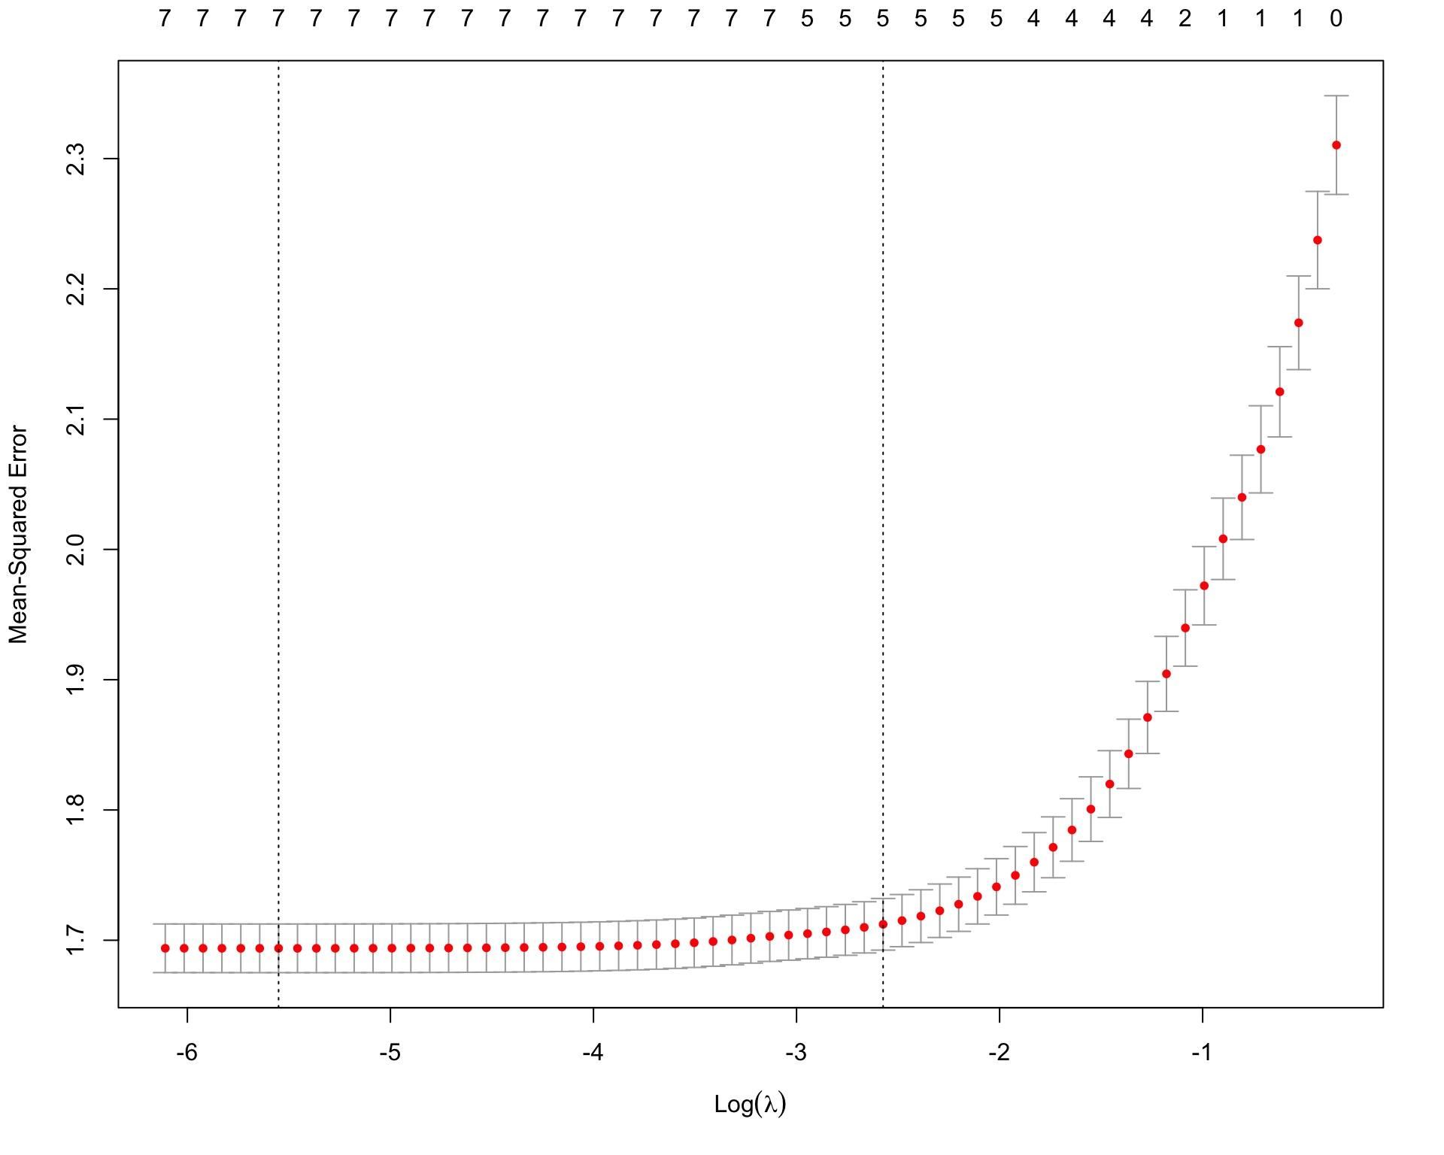
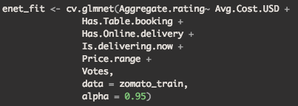
ENET CONTINUED
Optimal Lambda | 0.003539531
Notes:
Ben/Raina

Slide 11
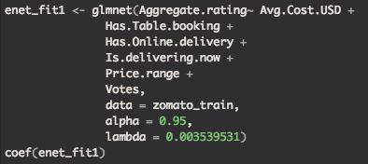
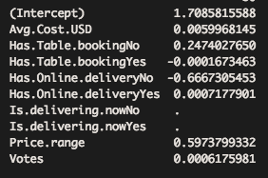
ENET CONTINUED
COEFFICIENTS
Notes:
Ben/Raina

Slide 12
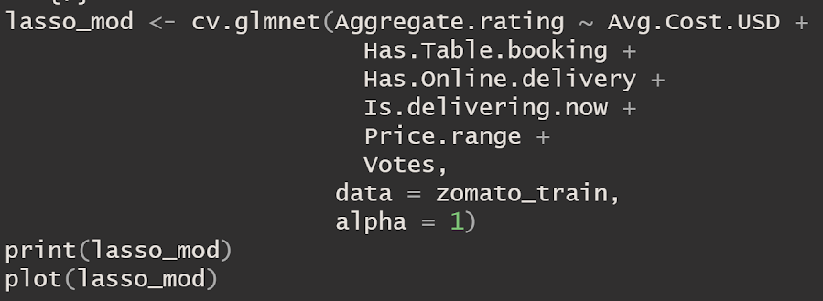
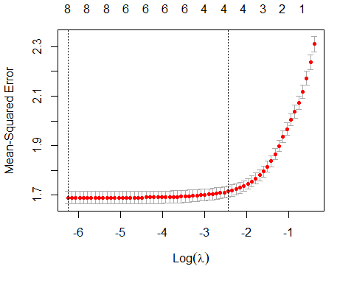
LASSO
Lambda.1se doesn’t increase MSE too much in comparison
Choose value of Lambda.1se to increase shrinkage
R2 | 0.254
RMSE | 1.302
Notes:
Nick

Slide 13
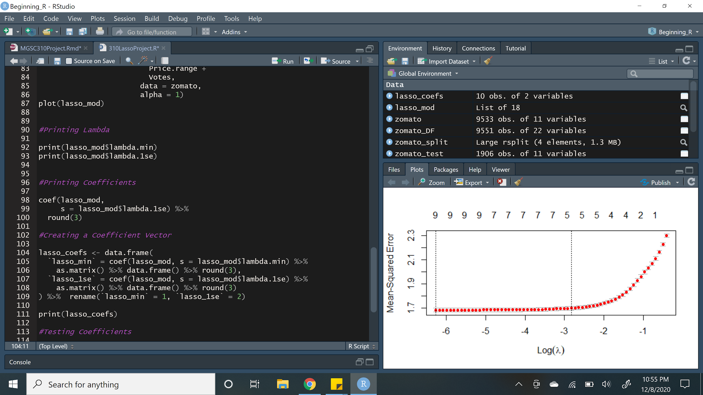
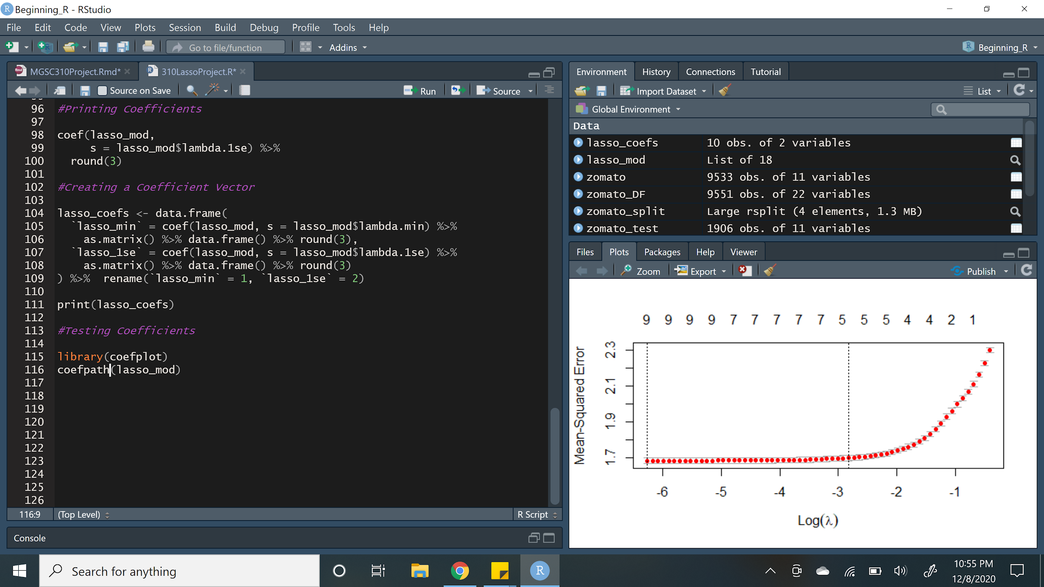
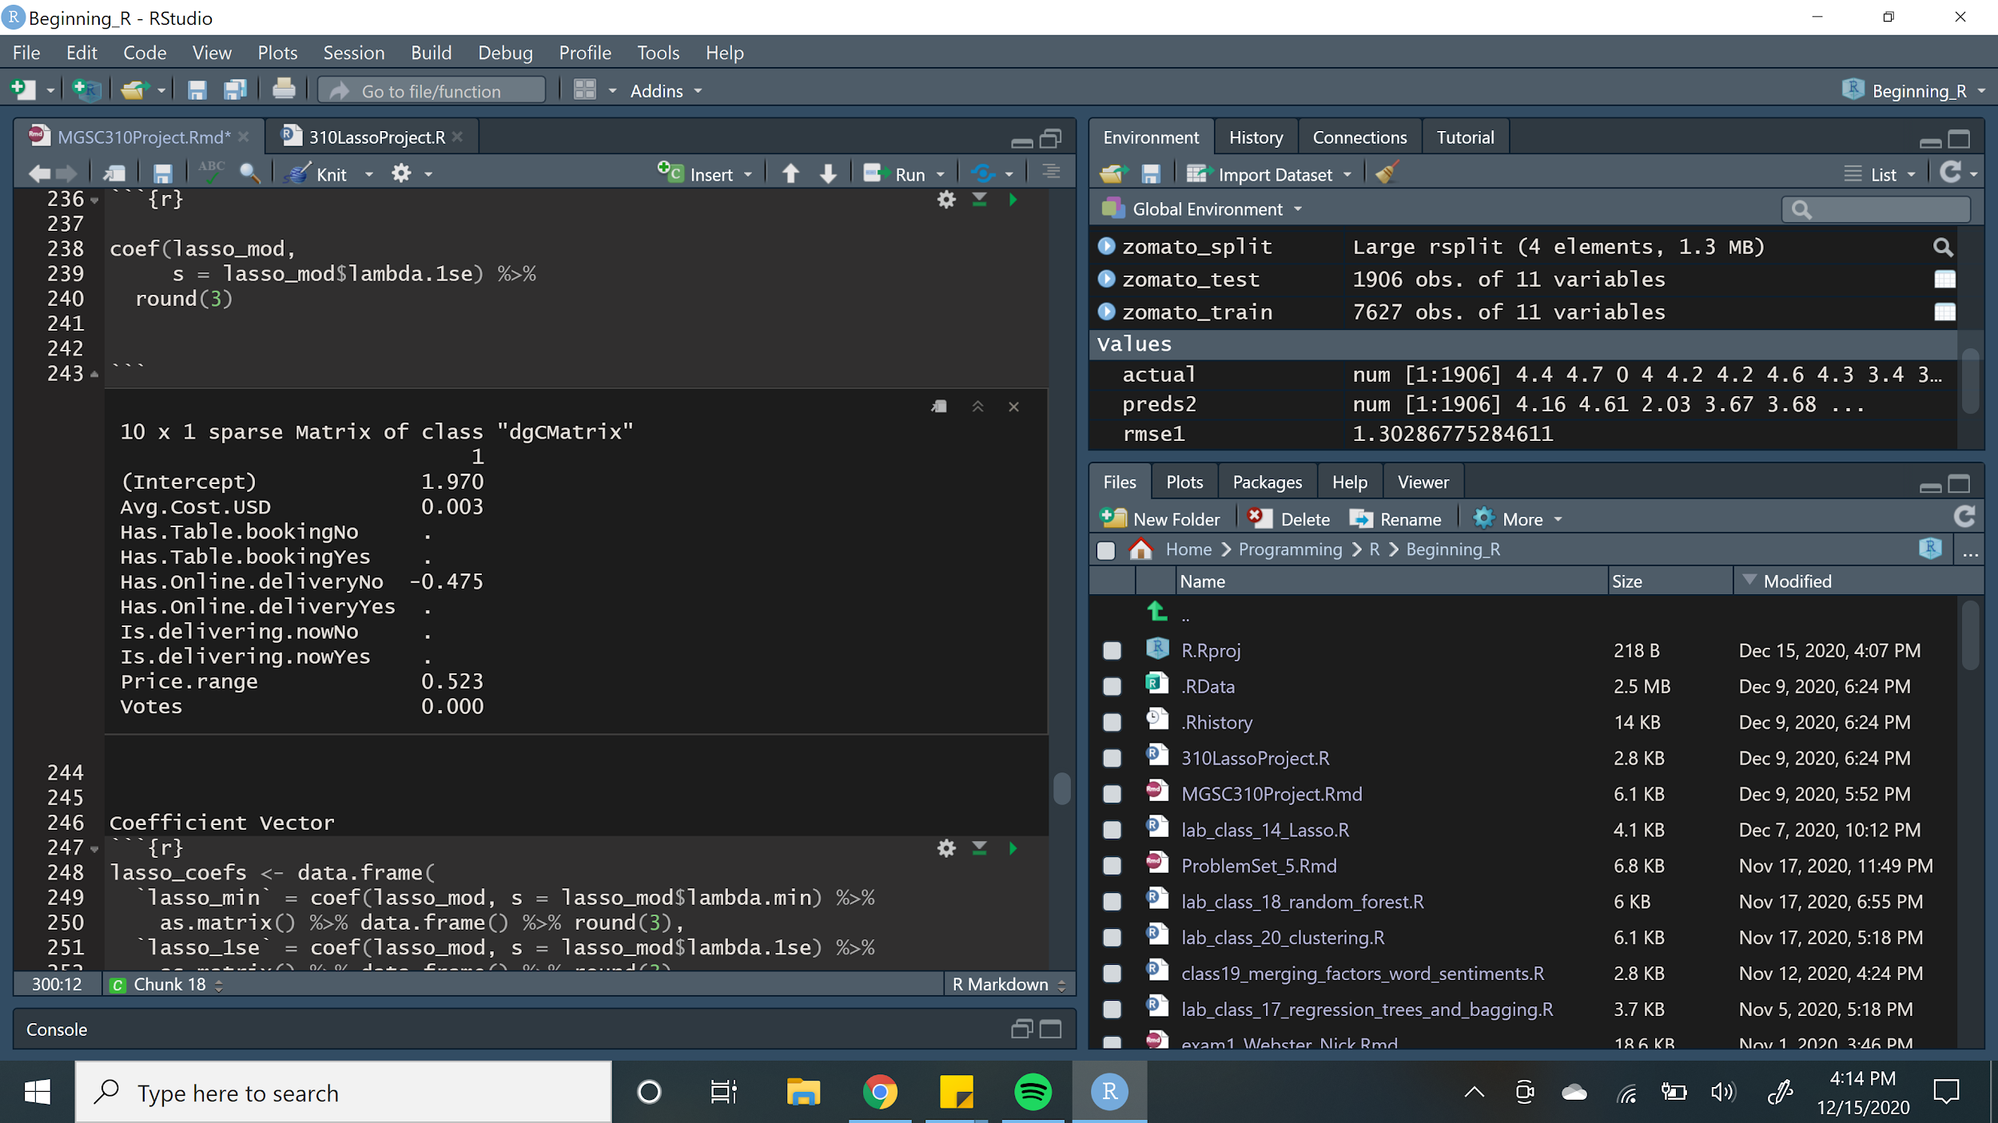
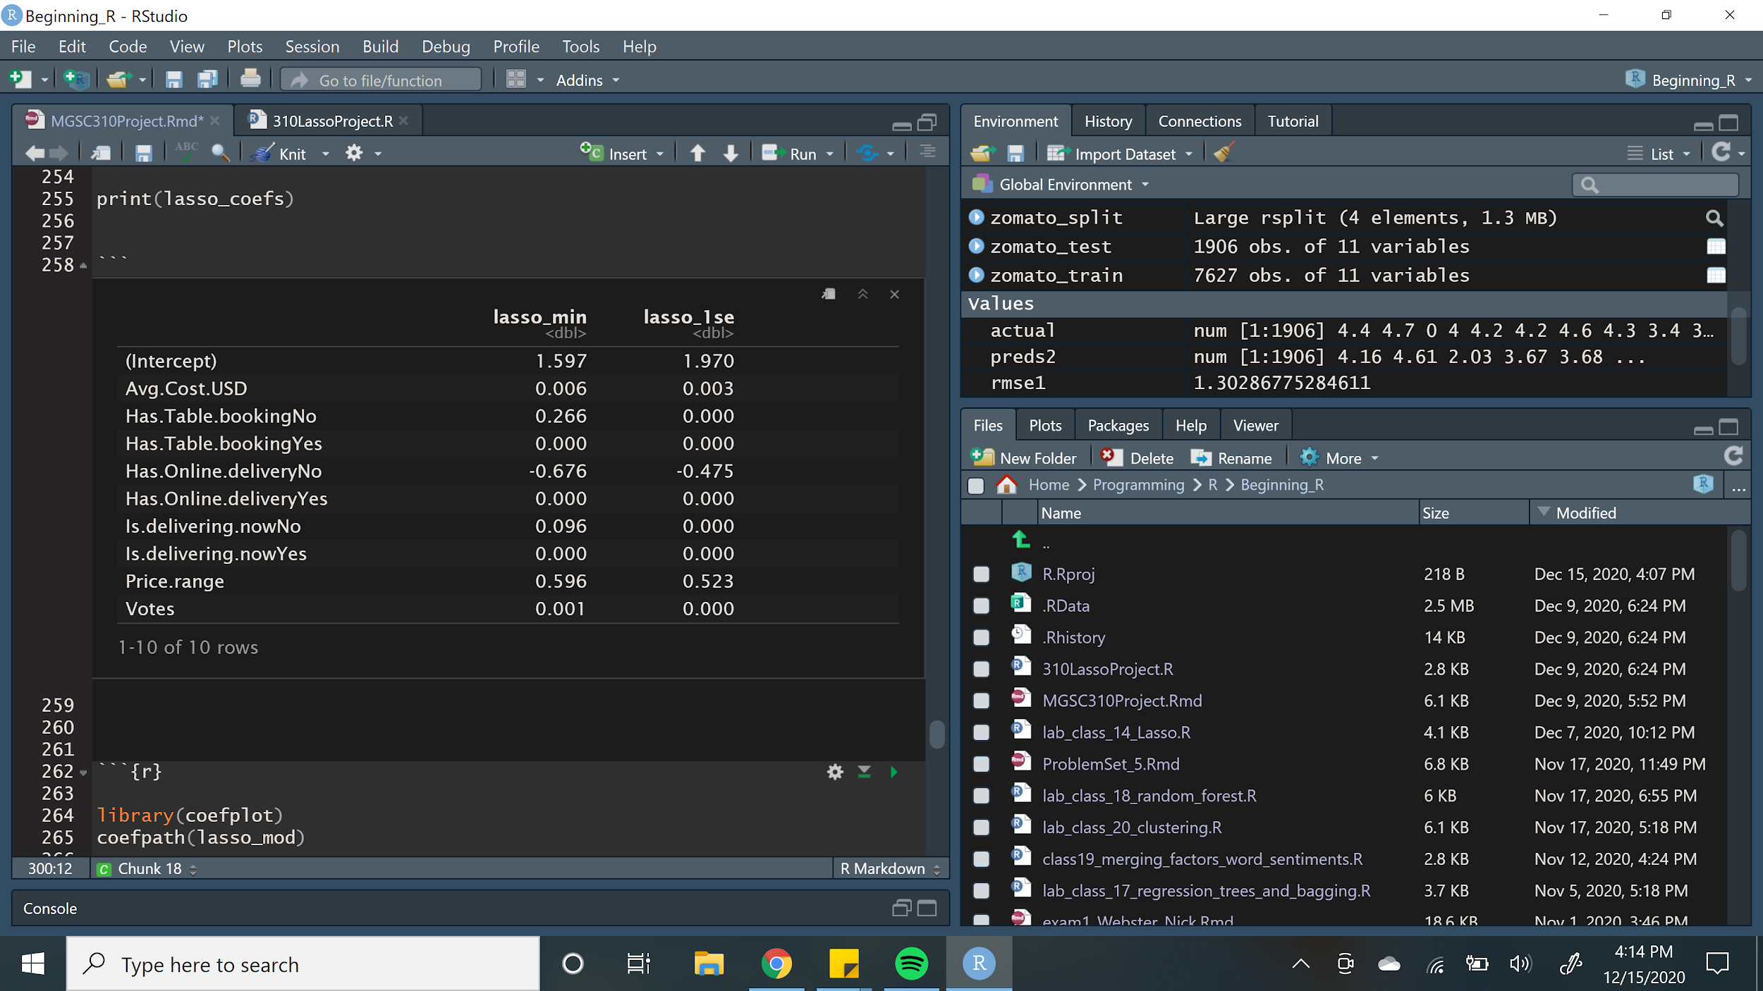
Lambda.min | 0.0019
Lambda.1se | 0.0871
Notes:
Nick

Slide 14
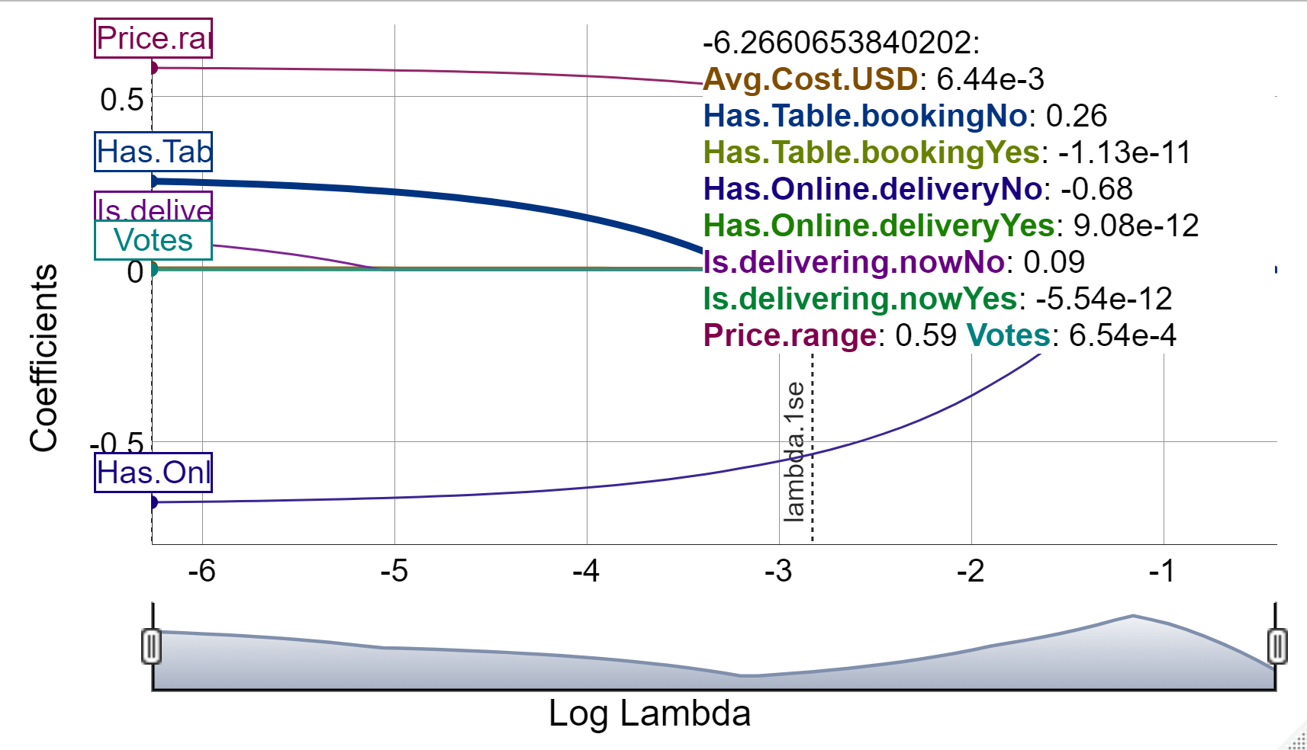
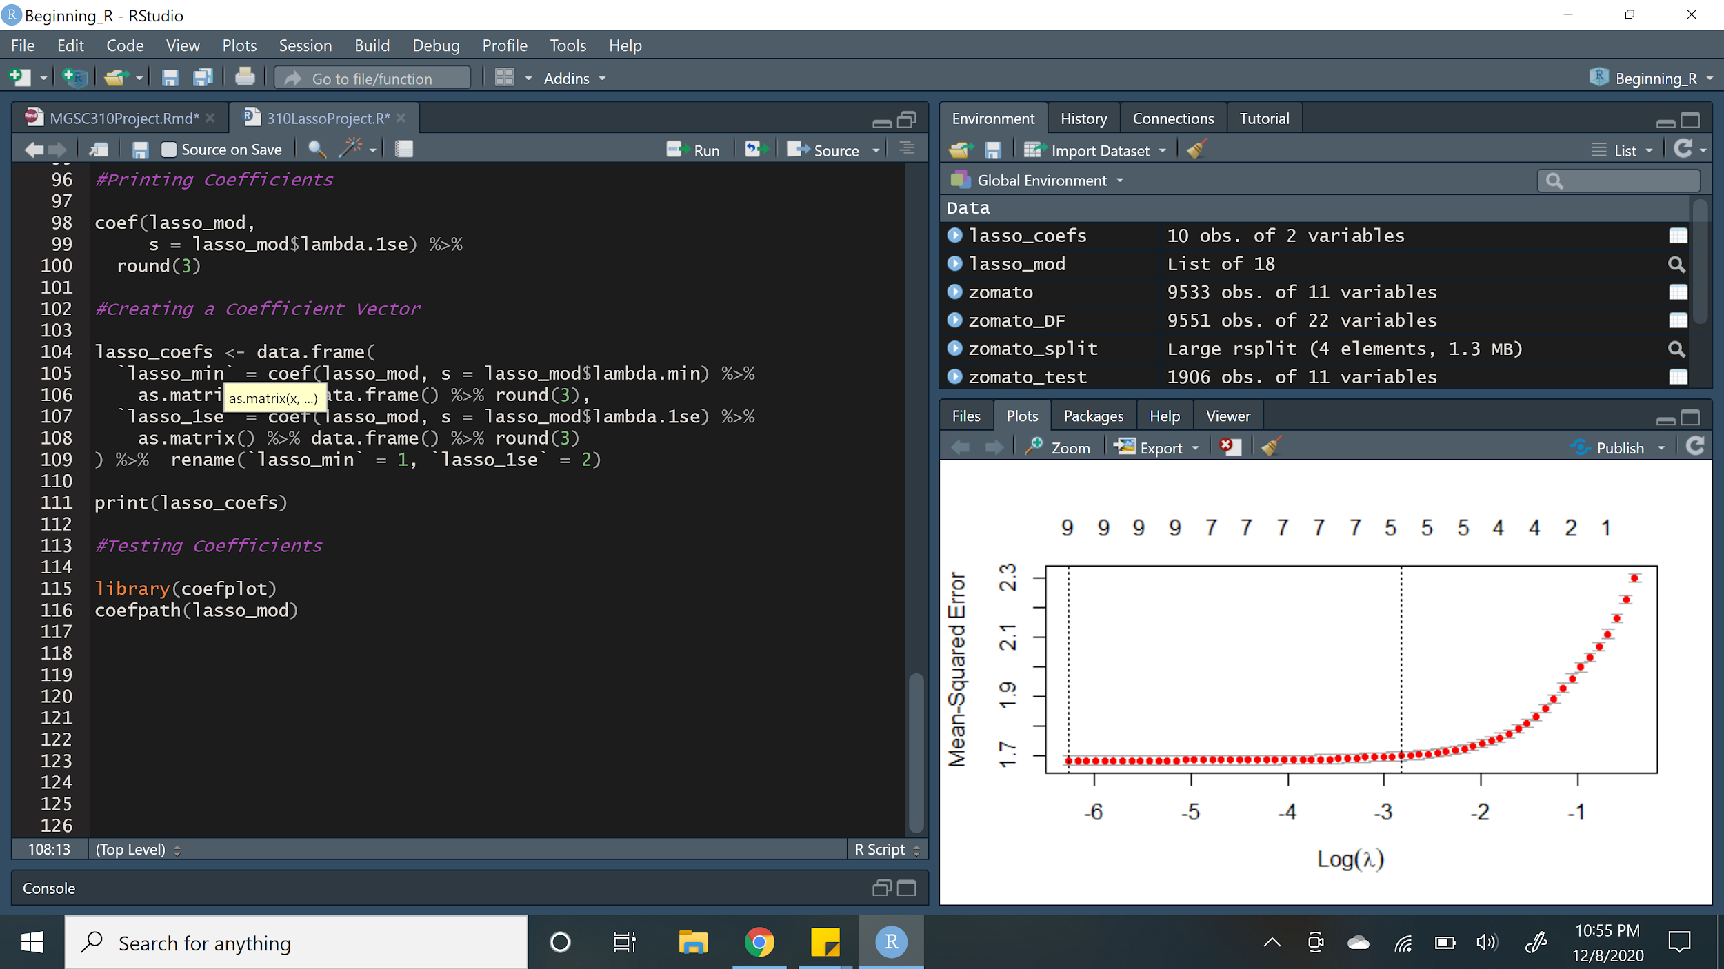
In this model, Has.Online.DeliveryNo and Price.Range have largest impact
Votes has little impact to our surprise in this model
Notes:
Nick

Slide 15
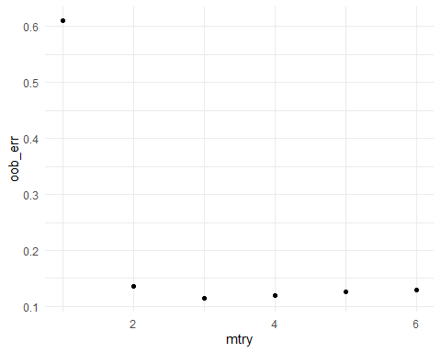
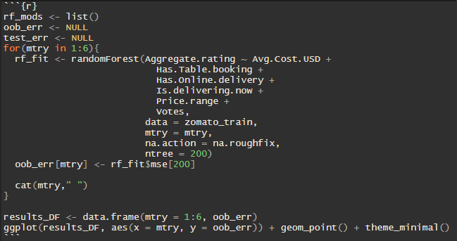
Random Forest Model
Notes:
Keivan

Slide 16
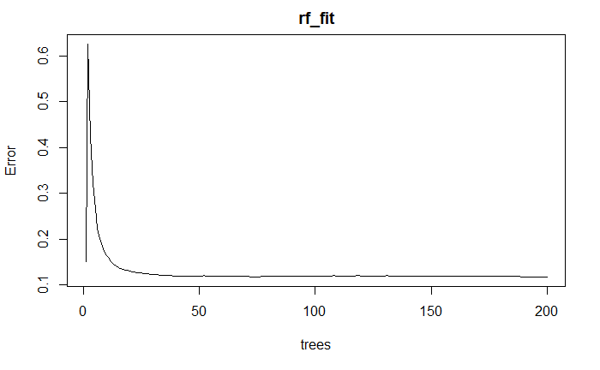
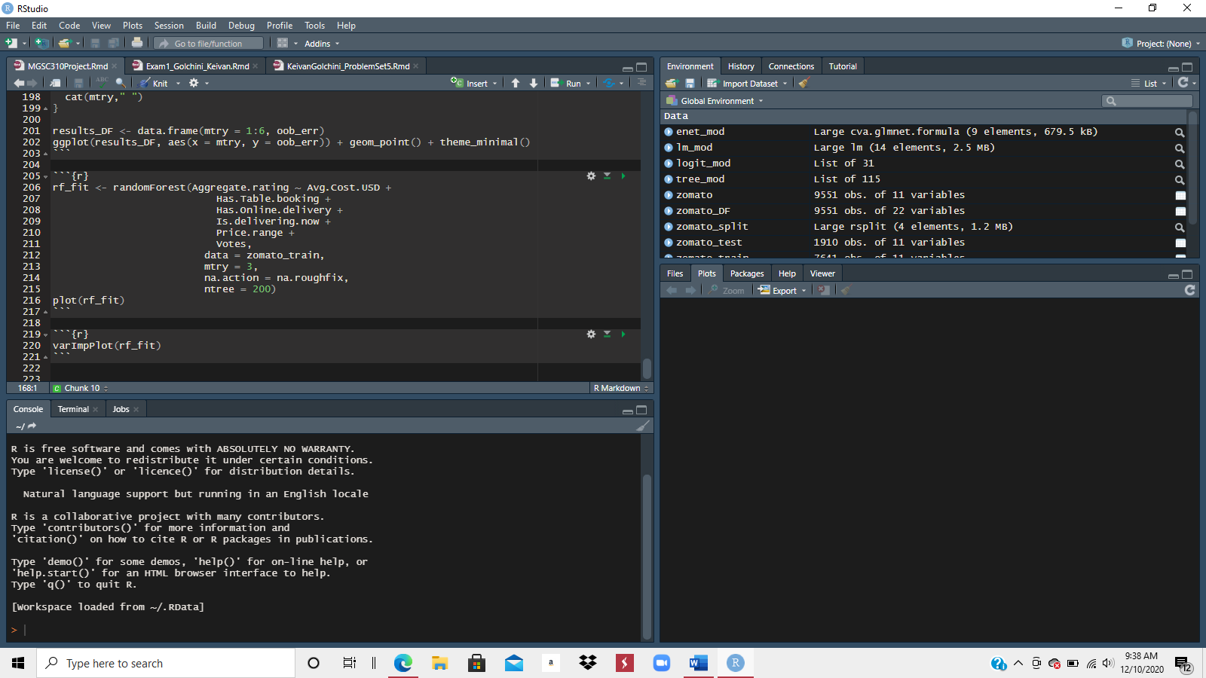
Random Forest Model
Notes:
Keivan

Slide 17
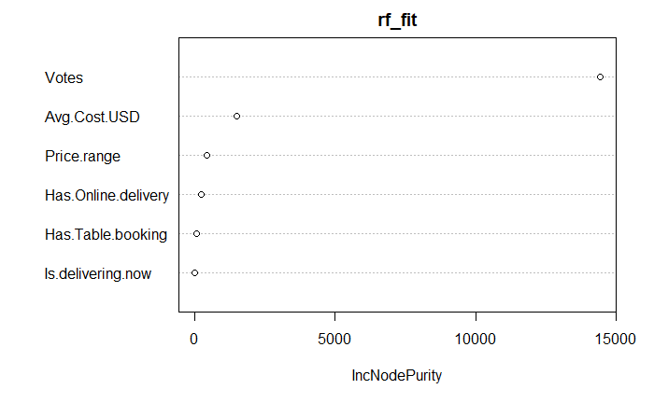
Random Forest Model
Train
R2 | 0.951
RMSE | 0.337
Test
R2 | 0.948
RMSE | 0.344
Notes:
Keivan

Slide 18
Conclusion
Linear
Lasso
Random Forest
R2 | 0.290
RMSE | 1.286
R2 | 0.254
RMSE | 1.302
R2 | 0.948
RMSE | 0.344
Best Model is Random Forest
Highest R2 and Lowest RMSE
Add more future variables
Notes:
Nick

Slide 19
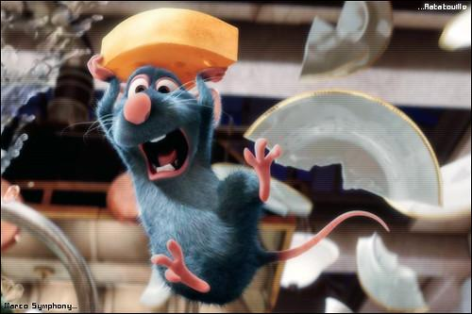
Thank You

